Slide 1
For Busy Feds: Boost Your Feedback Skills and See Powerful Results
Federal ADR Lunchtime Series Presentation
Tracey Cairnie and Megan Johnston, NVMS
March 28, 2018

Slide 2
Session Goals
Maximize Feedback Effectiveness to Prevent Disputes
Influence workplace productivity and satisfaction through effective feedback
Implement a simple model to deliver and
receive effective feedback
Apply verbal and non-verbal communication techniques to enhance feedback

Slide 3
Individual Activity
Close or lower your eyes while performing task
Listen carefully to the instructions
The goal is to ensure consistency

Slide 4
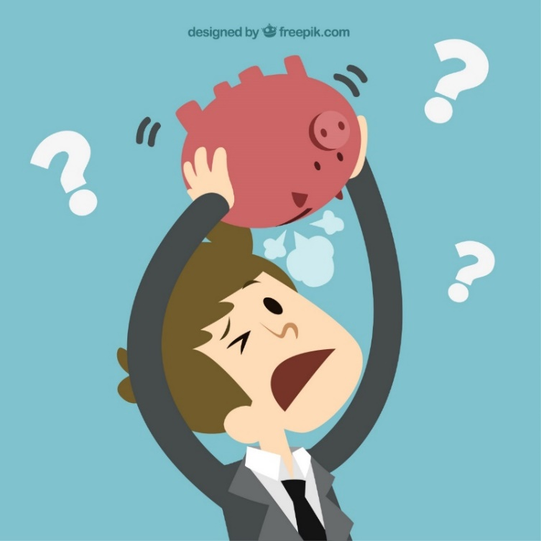
The Cost of Poor Communication
What happened during the activity?
What feedback would you give us to improve consistency?
How would you deliver that feedback?

Slide 5
When We Avoid Feedback
Often we are reticent to give or request feedback.
This is strongest when:
We are unsure of expectations;
There is low trust;
We are concerned with how
feedback will be received; or
We are unaware of how others
perceive us.
Why else?

Slide 6
Arc of Engagement
Judith Glaser’s Conversational Intelligence
Wait & See
Skeptic
Conditional Trust
Experimenter
Low Trust
High Trust
Resistor
Co-Creators
I Listening WE

Slide 7
Chemical Conversations
Judith Glaser’s Conversational Intelligence
Oxytocin
Dopamine
Serotonin
GABA
Noradrenaline
Adrenaline
Cortisol
Arousal & Stress
Connection, Pleasure & Calm

Slide 8
Oxytocin
Dopamine
Serotonin
GABA
Chemical Conversations
Judith Glaser’s Conversational Intelligence
Noradrenaline
Adrenaline
Cortisol
Upset
Upbeat
Happy
Rigid
Defensive
Worried
Engaged
Positive
Arousal & Stress
Connection, Pleasure & Calm

Slide 9
Regulating Feedback Conversations
C
H
A
N
G
E
Down regulate |  | Up-regulate
Exclude |  | Include
Judge |  | Appreciate
Limit |  | Expand
Withhold |  | Share
Know |  | Discover
Dictate |  | Develop
Criticize |  | Celebrate
Depleting
Nourishing
Judith Glaser’s Conversational Intelligence

Slide 10
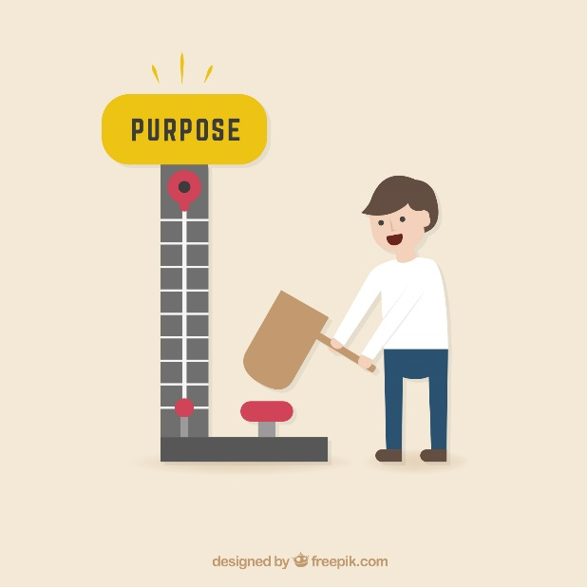
Benefits of Effective Feedback and Focusing on Strengths
Employees become more capable and confident
Employees grow and develop
Employees feel valued
Employees are more engaged
High-performing teams provide
six times more positive feedback
than average teams.

Slide 11
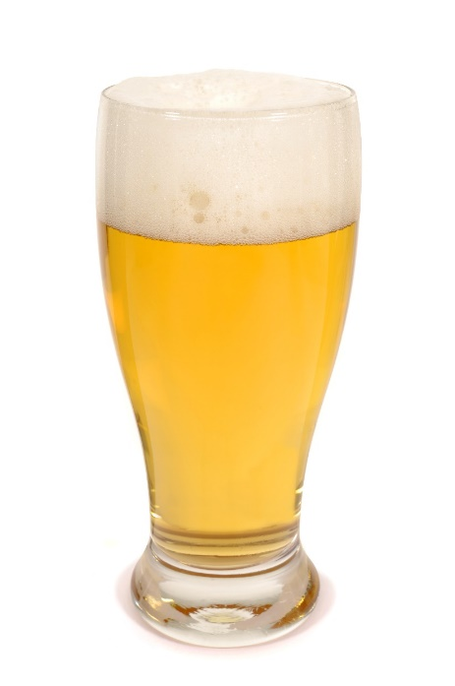
Four Steps to Effective, Verbal Feedback
Behavior
Effect
Expectation
Result

Slide 12
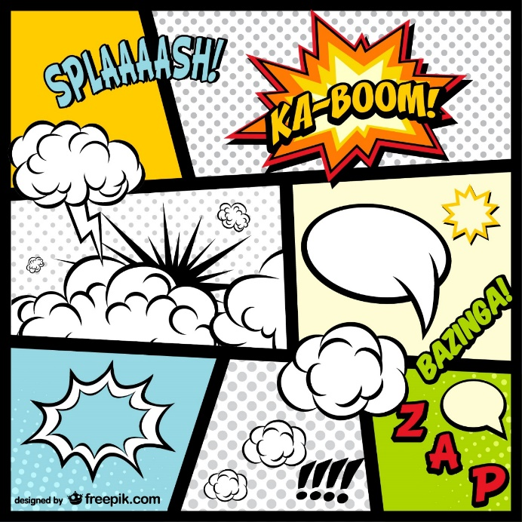
BEER: Behavior
Identify the behavior you want them to change
Behavior is:
Observable
It is NOT:
An assumption
An interpretation

Slide 13
BEER: Effect
Inquire as to their perception of the situation
Inquire about their intention
Describe what happens because of the identified behavior
Describe how it interferes with the
goal(s)

Slide 14
BEER: Expectation
Give clear feedback on what you want them to do differently, including
behaviors you want to
start, stop or change.

Slide 15
BEER: Result
Inquire as to their perception of
the situation’s impact
Inquire about their intention
Identify Potential Benefits and Consequences
If employee changes as requested; or
If current behavior continues.
Schedule follow up to check in

Slide 16
BEER Feedback Sample
I have noticed that ____________.
When this happens, ________ is impacted in _______ ways.
I am curious – how do you see it?
Moving forward, I expect ______ in order to achieve _______.
Let’s explore how you could meet this expectation ________ .
So you are agreeing to ______ and you understand, If you continue to do (the initial behavior), I will ________ (e.g. remove you from the project).
Let’s check back in ____________ to see how this is progressing.

Slide 17
The Rundown Video
https://youtu.be/wRNXAdIFEAM

Slide 18
Video Debrief
Who is responsible for the results you observed in the video?
What feedback could the employee have requested in this situation to save time and uncertainty?
What feedback could the manager have requested from the employee?
What barriers to the sharing of safe and effective feedback did you observe?

Slide 19
Nonverbal Elements of Feedback
People learn differently
Verbal
Nonverbal
Physiological
Use a combination of communication methods to ensure your instructions and feedback are received effectively

Slide 20
The Importance of Safety in Feedback
Building certain considerations into your feedback delivery will maximize the effectiveness and minimize the risks of negative repercussions
Bodily protection isn’t the only types of safety important to a successful workplace

Slide 21
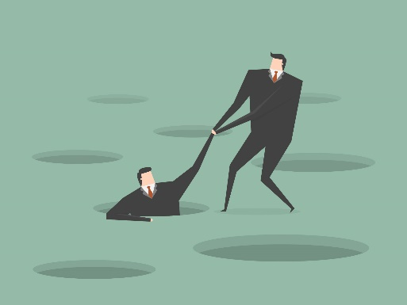
Safe Feedback is…
Given at frequent, predictable intervals
About learning (self awareness, observation, and reflection)
Emphasizes areas for improvement with goals and future focus, not criticisms
Given directly to the employee or colleague and without an audience
Reinforced and supported by leader examples

Slide 22
Yes!
Feedback Do’s
DO give feedback often
DO pay attention to your facial expression when giving feedback
DO be specific about what needs to change and how
DO explain the reason for the feedback
DO ask others for feedback
DO start with appreciation
DO use the words “yes, and”
DO approach with empathy
DO smile, even when giving feedback over the phone
DO be authentic
DO see feedback as an opportunity to connect
DO give feedback in a manner likely to be perceived as inclusive and supportive

Slide 23
No!
Feedback Don’ts
DO NOT wait until the annual performance review to give feedback
DO NOT speak in generalities
DO NOT use an aggressive tone of voice or body language
DO NOT use the imperative (e.g. “do this”)
DO NOT give walk-up negative feedback – prepare them
DO NOT just give a speech – effective feedback delivery will create productive conversations

Slide 24
Follow the simple BEER process for feedback,
Pay attention to nonverbal delivery, and
Watch your employees’ productivity improve!

Slide 25
Thank you
Tracey Cairnie, tcairnie@corevisionllc.com, (571) 214-3692
Owner, CoreVision, LLC; Trainer, Coach & Mediator, NVMS
Megan Johnston, director@nvms.us, (703) 865-7260
Executive Director, NVMS
Feel free to contact us with questions!

Slide 26
Additional Resources
Glaser, Judith E. Conversational Intelligence. How Great Leaders Build Trust and Get Extraordinary Results. (2014).
Kaye, Beverly and Giulioni, Julie Winkle. Help Them Grow or Watch Them Go. (2012).
Stone, Douglas and Heen, Sheila. Thanks for the Feedback: The Science and Art of Receiving Feedback Well. (2015)

